Slide 1
Introduction to
Java Programming
for High School
{
< Here is where your presentation begins >
}
...

Slide 2
Contents of this template
You can delete this slide when you’re done editing the presentation
Fonts | To view this template correctly in PowerPoint, download and install the fonts we used
Used and alternative resources | An assortment of graphic resources that are suitable for use in this presentation
Thanks slide | You must keep it so that proper credits for our design are given
Colors | All the colors used in this presentation
Icons and infographic resources | These can be used in the template, and their size and color can be edited
Editable presentation theme | You can edit the master slides easily. For more info, click here
For more info: SLIDESGO | BLOG | FAQS
You can visit our sister projects: FREEPIK | FLATICON | STORYSET | WEPIK | VIDEVO

Slide 3
Table of contents
01
02
03
Section
You can describe the topic of the section here
Section
You can describe the topic of the section here
Section
You can describe the topic of the section here

Slide 4
Whoa!
}
< This can be the part of the presentation where you introduce yourself, write your email… >
*

Slide 5
01
Name of the section
{
..
< You can enter a subtitle here if you need it >
}
..

Slide 6
Do you need longer text?
Mercury is the closest planet to the Sun and the smallest one in the entire Solar System. This planet's name has nothing to do with the liquid metal, since Mercury was named after the Roman messenger god. It isn’t as hot as Venus, for instance
Mercury takes a little more than 58 days to complete its rotation, so try to imagine how long days must be there! Since the temperatures are so extreme, albeit not as extreme as on Venus, Mercury has been deemed to be non-habitable for humans
}
..

Slide 7
The slide title goes here!
*
Do you know what helps you make your point crystal clear? Lists like this one:
They’re simple
You can organize your ideas clearly
You’ll never forget to buy milk!
And the most important thing: the audience won’t miss the point of your presentation

Slide 8
You can divide the content
{
Mercury
Venus
Mercury is the closest planet to the Sun and the smallest one in the Solar System—it’s only a bit larger than the Moon
Venus has a beautiful name and is the second planet from the Sun. It’s hot and has a poisonous atmosphere
}
*

Slide 9
Here are three ideas
...
Mercury
Mercury is the closest planet to the Sun and the smallest of them all
Venus
Mars
Venus has a beautiful name and is the second planet from the Sun
Despite being red, Mars is actually a cold place. It’s full of iron oxide

Slide 10
Practical exercise 01
Write a Java program to print 'Hello' on screen and then print your name on a separate line.
Expected output:
Hello
Sofia Hill
*

Slide 11
Here are four concepts
Mars
Venus
Despite being red, Mars is a cold place
Venus has a nice name and a very toxic atmosphere
Jupiter
Saturn
Jupiter is the biggest planet of them all
Saturn is a gas giant and has several rings

Slide 12
Here are six concepts
{
..
Mars
Venus
Neptune
Despite being red, Mars is a cold place
Venus has a nice name and a very toxic atmosphere
Neptune is the farthest planet from the Sun
Mercury
Saturn
Jupiter
Mercury is the closest planet to the Sun
Saturn is a gas giant with several rings
Jupiter is the biggest planet of them all
*
}
..

Slide 13
Practical exercise 02
Write a Java program to divide two numbers and print on the screen.
Test data:
80/2
Expected output:
40
}
..

Slide 14
Awesome words
{
..
}
..

Slide 15
Practical exercise 03
Write a Java program that takes two numbers as input and displays the product of two numbers.
Test data:
Input first number: 70
Input second number: 4
Expected output:
70 x 4 = 280
*

Slide 16
—Someone Famous
{
..
“This is a quote, words full of wisdom that someone important said and that can inspire the reader.”
}
..

Slide 17
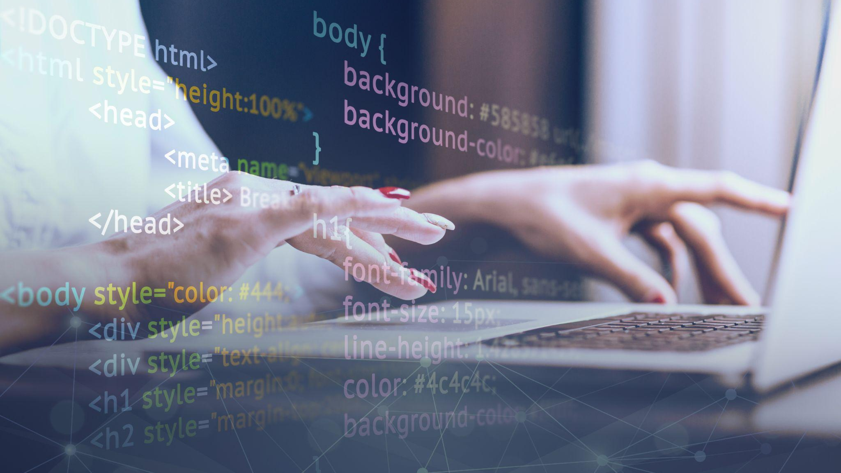
A picture is worth a thousand words

Slide 18

A picture always reinforces
the concept
Images reveal large amounts of data, so remember: use an image instead of a long text. Your audience will appreciate it
*

Slide 19
Practical exercise 04
Write a Java program to print the sum (addition), multiplication, subtraction, division and remainder of two numbers.
Test data:
Input first number: 200
Input second number: 55
Expected Output:
200 + 55 = 255
200 - 55 = 145
200 x 55 = 11000
200 / 55 = 3,63
200 mod 5 = 35
}
..

Slide 20
98,300,000
{
< Big numbers catch your audience’s attention >
}

Slide 21
9h 55m 23s
333,000
386,000 km
Jupiter’s rotation period
The Sun’s mass compared to Earth’s
Distance between Earth and the Moon

Slide 22
Let’s use some percentages
25%
50%
75%
*
Mercury
Venus
Mars
Mercury is the closest planet to the Sun and the smallest one
Venus has a beautiful name and is the second planet from the Sun
Despite being red, Mars is actually a cold place. It’s full of iron oxide

Slide 23
Practical exercise 05
Write a Java program to convert a binary number into a hexadecimal number.
Input data:
Input a binary number: 10010
Expected output:
Hexadecimal value: D
*

Slide 24
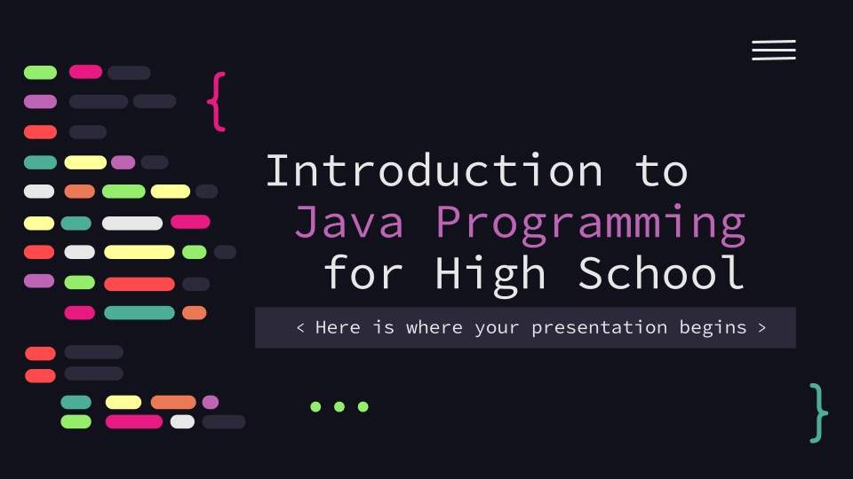
Computer mockup
{
You can replace the image on the screen with your own work. Just right-click on it and select “Replace image”
}
...

Slide 25
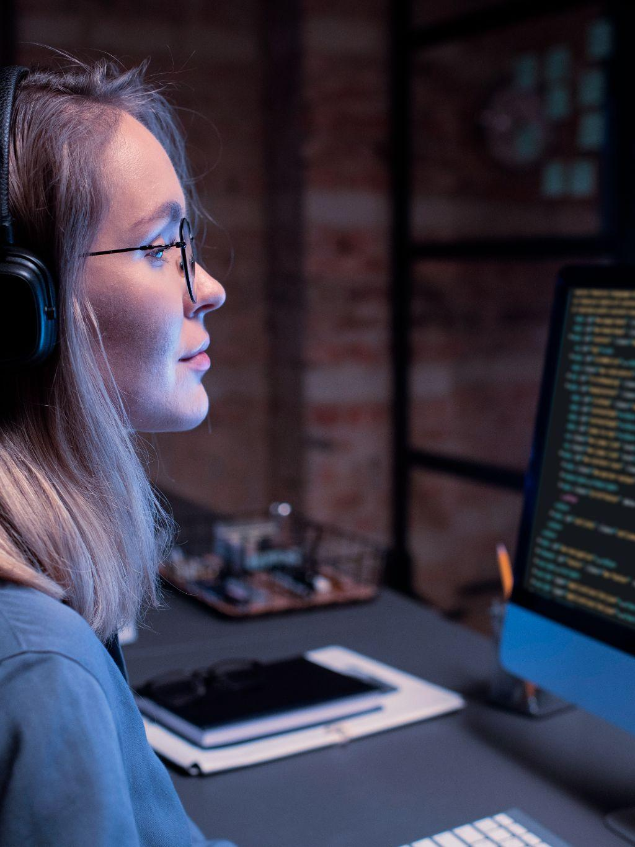
Tablet mockup
{
You can replace the image on the screen with your own work. Just right-click on it and select “Replace image”
}

Slide 26
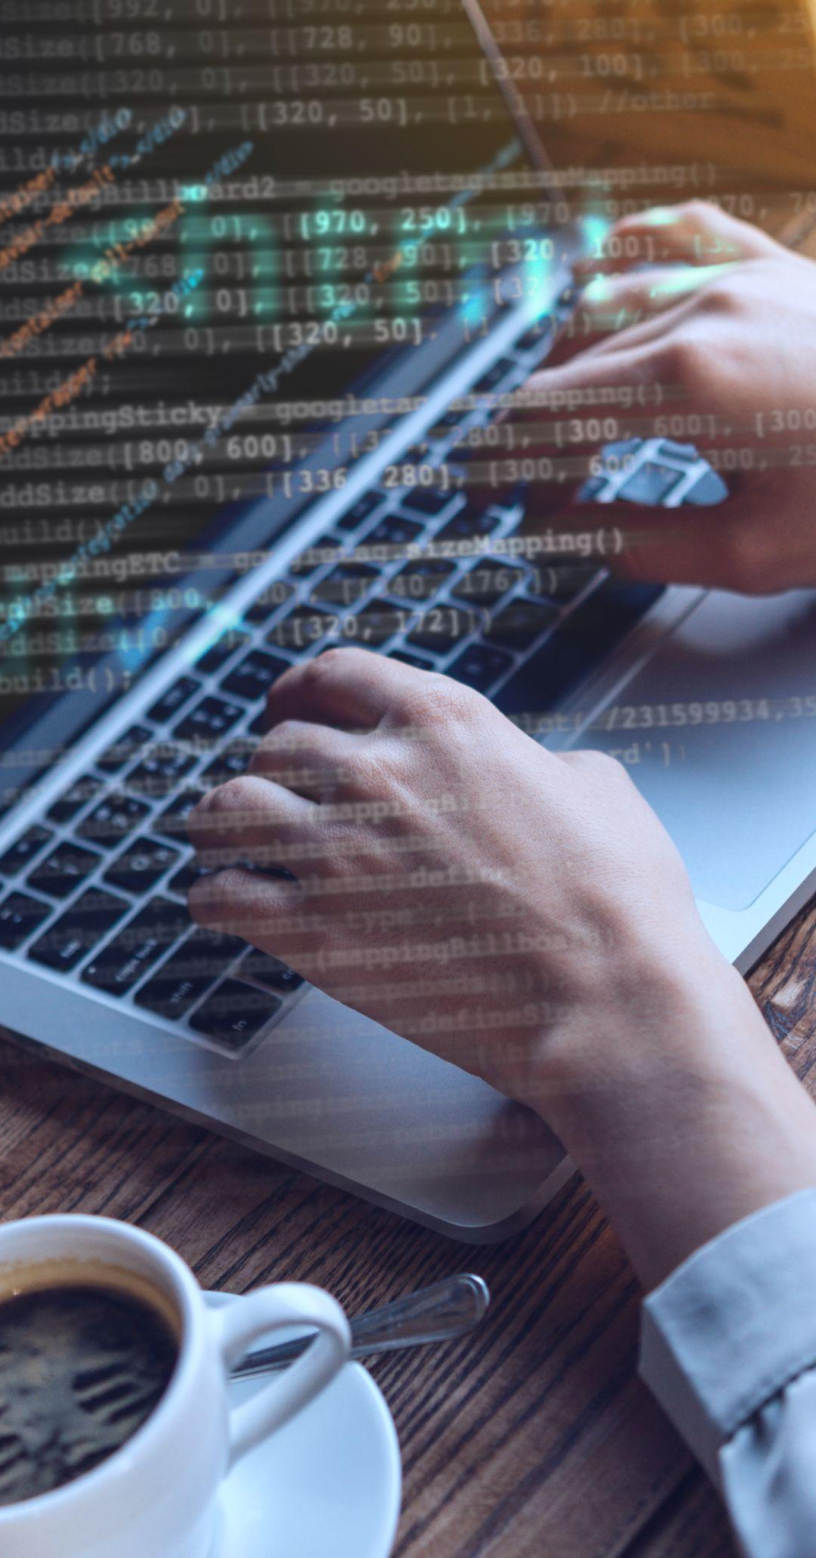
Phone mockup
{
You can replace the image on the screen with your own work. Just right-click on it and select “Replace image”
}
...

Slide 27
This is a map
{
..
Venus
Venus is the second planet from the Sun
Mercury
Mercury is the closest planet to the Sun
Mars
Despite being red, Mars is a very cold place
*
}
..

Slide 28
A timeline always works well
{
*
Venus is the second planet from the Sun
Despite being red, Mars is a very cold place
Mercury is the closest planet to the Sun
Jupiter is the biggest planet of them all
}

Slide 29
Infographics are useful
{
..
Mars
Venus
Mars is a
red planet
Solar System
Venus is a
hot planet
Mercury
Jupiter
Mercury is
very small
Jupiter is a
gas giant
}
..

Slide 30
Practical exercise 06
Write a Java program to check whether Java is installed on your computer.
Expected output:
Java Version: 1.8.0_71
Java Runtime Version: 1.8.0_71-b15
Java Home: /opt/jdk/jdk1.8.0_71/jre
Java Vendor: Oracle Corporation
Java Vendor URL: http://Java.oracle.com/
Java Class Path: .

Slide 31
Use tables to represent data
{
 | Team A | Team B | Team C | Team D
Mercury | 0.06 | 0.53 | 0.38 | 0.38
Mars | 0.11 | 9.4 | 0.53 | 0.78
Saturn | 95.2 | 1.16 | 9.4 | 1.16
}

Slide 32
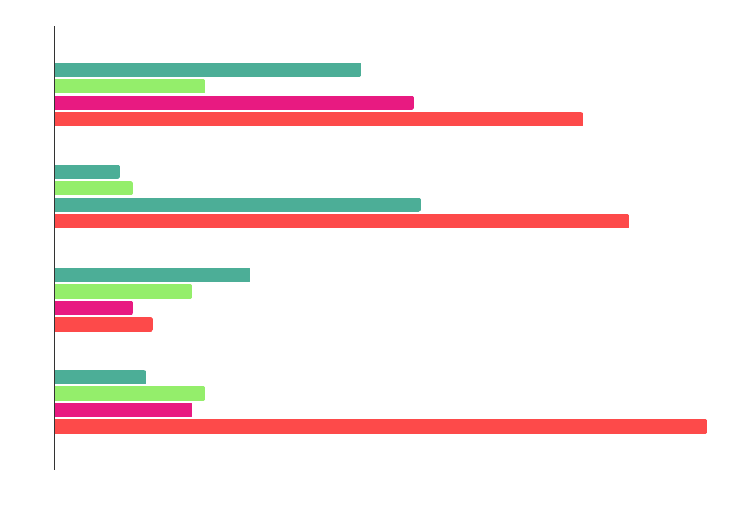
You can use this graph
Mercury
Venus
Jupiter
Saturn
*
Mercury is the smallest planet
Venus has very high temperatures
Jupiter is the biggest planet
Saturn is a gas giant with rings
Follow the link in the graph to modify its data and then paste the new one here. For more info, click here

Slide 33
Practical exercise 07
Write a Java program to reverse a string.
Input data:
Input a string: My dog’s name is Ralph
Expected output:
Reverse string: hplaR si eman s‘god yM

Slide 34


Our team
{
*
..
Sofia Hill
Alex Harris
You can speak a bit about this person here
You can speak a bit about this person here
}
..

Slide 35
Thanks!
< Do you have any questions? >
youremail@freepik.com
+34 654 321 432
yourwebsite.com
Please keep this slide for attribution

Slide 36
Alternative resources
Here’s an assortment of alternative resources whose style fits the one of this template:
Programmers concept with flat design

Slide 37
Resources
Did you like the resources on this template? Get them for free at our other websites:
Photos
Html and css collage concept with person I
Html and css collage concept with person II
Html and css collage concept with person III
Html and css collage concept with person IV
Medium shot smiley woman at library
Medium shot man holding notebook

Slide 38
Instructions for use
If you have a free account, in order to use this template, you must credit Slidesgo by keeping the Thanks slide. Please refer to the next slide to read the instructions for premium users.
As a Free user, you are allowed to:
Modify this template.
Use it for both personal and commercial projects.
You are not allowed to:
Sublicense, sell or rent any of Slidesgo Content (or a modified version of Slidesgo Content).
Distribute Slidesgo Content unless it has been expressly authorized by Slidesgo.
Include Slidesgo Content in an online or offline database or file.
Offer Slidesgo templates (or modified versions of Slidesgo templates) for download.
Acquire the copyright of Slidesgo Content.
For more information about editing slides, please read our FAQs or visit our blog:
https://slidesgo.com/faqs and https://slidesgo.com/slidesgo-school

Slide 39
Instructions for use (premium users)
As a Premium user, you can use this template without attributing Slidesgo or keeping the Thanks slide.
You are allowed to:
Modify this template.
Use it for both personal and commercial purposes.
Hide or delete the “Thanks” slide and the mention to Slidesgo in the credits.
Share this template in an editable format with people who are not part of your team.
You are not allowed to:
Sublicense, sell or rent this Slidesgo Template (or a modified version of this Slidesgo Template).
Distribute this Slidesgo Template (or a modified version of this Slidesgo Template) or include it in a database or in any other product or service that offers downloadable images, icons or presentations that may be subject to distribution or resale.
Use any of the elements that are part of this Slidesgo Template in an isolated and separated way from this Template.
Register any of the elements that are part of this template as a trademark or logo, or register it as a work in an intellectual property registry or similar.
For more information about editing slides, please read our FAQs or visit our blog:
https://slidesgo.com/faqs and https://slidesgo.com/slidesgo-school

Slide 40
Fonts & colors used
This presentation has been made using the following fonts:
Source Code Pro
(https://fonts.google.com/specimen/Source+Code+Pro)
#e7e7e7
#10111a
#fd4a4a
#ec7955
#e81a81
#94ee6b
#4cae97
#bd64b5
#ffff99
#2c293a

Slide 41





Storyset
Create your Story with our illustrated concepts. Choose the style you like the most, edit its colors, pick the background and layers you want to show and bring them to life with the animator panel! It will boost your presentation. Check out how it works.
Pana
Amico
Bro
Rafiki
Cuate

Slide 42
Use our editable graphic resources...
You can easily resize these resources without losing quality. To change the color, just ungroup the resource and click on the object you want to change. Then, click on the paint bucket and select the color you want. Group the resource again when you’re done. You can also look for more infographics on Slidesgo.

Slide 45
JANUARY
FEBRUARY
MARCH
APRIL
MAY
JUNE
PHASE 1
Task 1
Task 2
PHASE 2
Task 1
Task 2
JANUARY
FEBRUARY
MARCH
APRIL
PHASE 1
Task 1
Task 2

Slide 48
...and our sets of editable icons
You can resize these icons without losing quality.
You can change the stroke and fill color; just select the icon and click on the paint bucket/pen.
In Google Slides, you can also use Flaticon’s extension, allowing you to customize and add even more icons.

Slide 49
Educational Icons
Medical Icons

Slide 50
Business Icons
Teamwork Icons

Slide 51
Help & Support Icons
Avatar Icons

Slide 52
Creative Process Icons
Performing Arts Icons

Slide 53
Nature Icons

Slide 54
SEO & Marketing Icons

Slide 55


